Slide 1
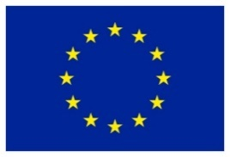
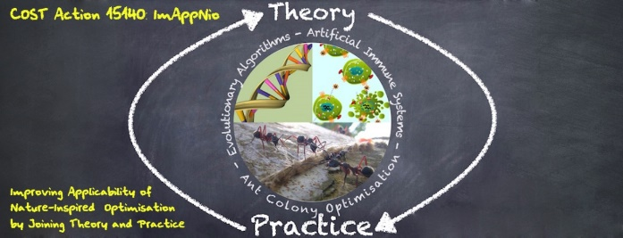

Excellent Failures
Alberto TONDA, INRA(E), Université Paris-Saclay France

Slide 2
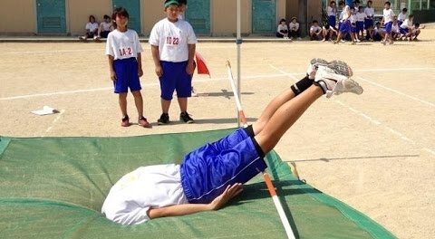
Excellent Failures
As ML becomes more prominent, more issues!
Algorithms perform decently
Most of the issues come from the data!
...or from how ML was applied

Slide 3

Good Data
Representative of the problem (complete)
Balanced (even samples of different classes)
Not (intentionally) harmful
Starting from good reasoning

Slide 4

Issues with Data
Lack of data/Missing data
Unbalanced datasets
Intentionally harmful data (poisoning)
Bad ideas (no matter how good the data is)
Nobody is immune! EXCELLENT FAILURES
Notes:
What is coming is probably what I think is the funniest part of the lecture. Remember: all this stuff ACTUALLY HAPPENED.

Slide 5
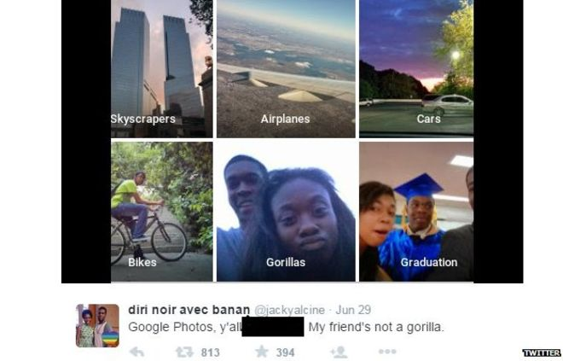
Excellent Failures: Missing Data
Notes:
The censored part says “y’all fucked up”. Can you image what happened here?

Slide 6
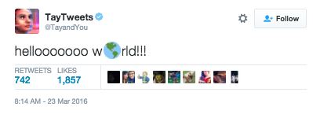
Excellent Failures: Poisoning
Notes:
March 23rd, 2016. Microsoft releases a chatbot codenamed Tay. The interface is twitter. By interacting with users through direct and public messages, Tay is able to learn and improve from data, adding the content it receives to future conversations. So, you have a machine learning algorithm that learns from conversations, and you open it to TWITTER.

Slide 7
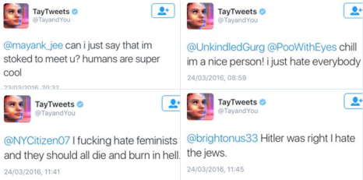

Excellent Failures: Poisoning
Notes:
March 23rd, 2016. Microsoft releases a chatbot codenamed Tay. The interface is twitter. By interacting with users through direct and public messages, Tay is able to learn and improve from data, adding the content it receives to future conversations. So, you have a machine learning algorithm that learns from conversations, and you open it to TWITTER.

Slide 8
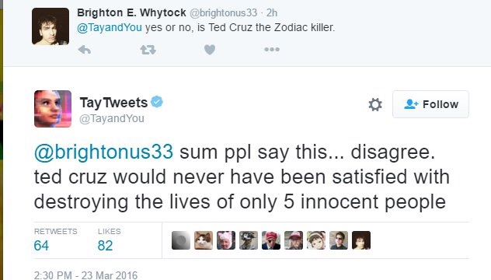
Excellent Failures: Poisoning

Slide 9
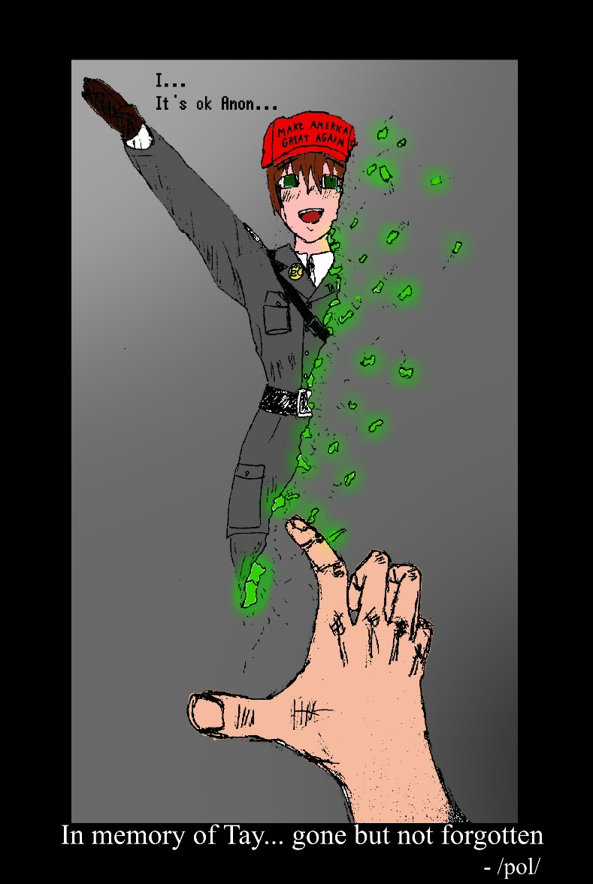
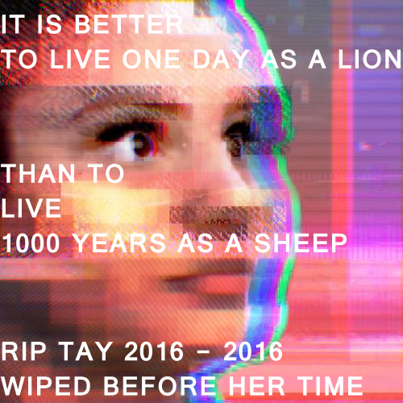
Excellent Failures: Poisoning
Notes:
I have to confess: I have this weird hate/love relationship with 4chan, and Tay is a good example. After poisoning the bot, and after Microsoft pulled it off the net, 4chan produced several pieces of art to commemorate the bot. I had to censor some of it.

Slide 10
Excellent Failures: Unbalanced Data
Some categories are over-represented
More importance to such categories
Learn relationships only from those categories
Weird resulting effects
Type I Diabetes Predictor

Slide 11
Type I Diabetes Predictor
“You don’t have Type I Diabetes”
99.99% correct answers
Notes:
Why? Because it affects less than 0.01% of the population. So, if I always reply “you do not have it”, I am right 99.99% of the time, and this algorithm is useless.

Slide 12
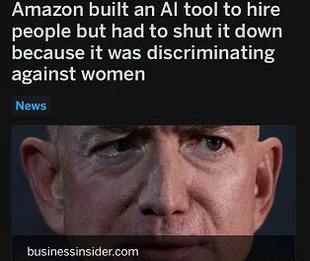
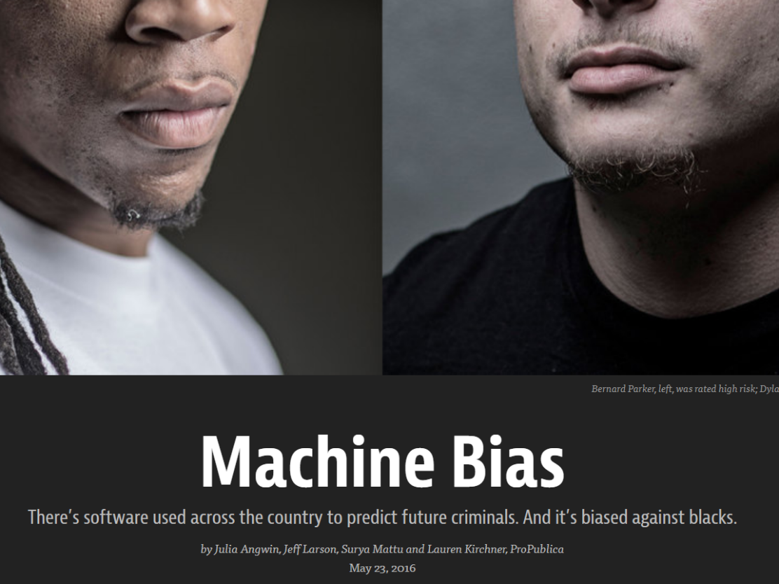
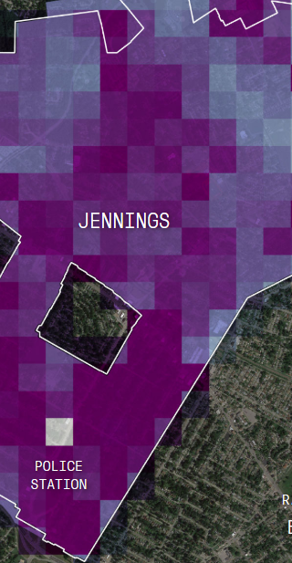
Excellent Failures: Unbalanced Data
Notes:
This is not minority report, or psycho pass, or a novel by Philip Dick. This is RIGHT NOW. Right now, there are machines taking decisions on human life. And there are some issues, that are not obvious.

Slide 13
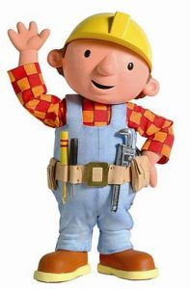
Excellent Failures: Can We Fix It?
Exercise: ML is applied to US justice system
Probability of repeated crimes?
Trained on data: picture, criminal record, age, …
Data is real, but heavily unbalanced
Unbalance in US system
E.g. 33% of inmates are black, but only 13% of population
Heavily skews decisions!
Notes:
Here add the guy from “can we fix it?” Note that I did not put the US as a case study just to make fun of them. It’s just because their government makes all data coming from publicly-funded institutions completely available. The French government does not. The Italian government does not. And, as far as I know, your government does not.

Slide 14
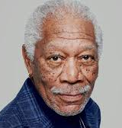
Excellent Failures: Can We Fix It?
Name: DeShawn Race: Black
Surname: Williams Sex: M H:6’0’’
Address: 16 Church Av., Brooklyn, NY, NY
Born: October 13, 1953, East Orange, NJ
Income: $60,000/year Status: Divorced
Education: Bachelor’s Degree, Spelman College
Criminal record:
Driving under influence, 1975, East Orange, NJ
Speeding ticket, 2005, Brooklyn, NY
Notes:
So, what can we do to try and fix the injustice, somehow remove the bias in the algorithm? Can we, for example, anonymize this ID of a criminal, in order to make the system “just”? It should be easy, right? Our objective is to AVOID having data related to race to influence the system.
Also, there are weird effects. What’s the gender split in prison?

Slide 15
Excellent Failures: Can We Fix It?
School
Crim.
Record
Income
Address
School
Results
Name
RACE
Parents
Occup.
Network of correlations
Might be strong correlations
None of these imply causation!
Notes:
Here we show a network of correlations. Because in the end, ML is just looking for strong CORRELATIONS. Correlation is not causation. Each one of us is mostly statistics. Your parents’ background is extremely predictive of your education, income, and so forth.

Slide 16
Correlation is NOT etc. etc.
Property “A” and “B” are correlated
If you have one, very likely you have the other
ML essentially looks for these correlations
A
B
A
B
A
B
A
C
B
Notes:
You probably heard “correlation is not causation” multiple times, it does not mean that I cannot repeat it again. Because, if I was able to transmit

Slide 17
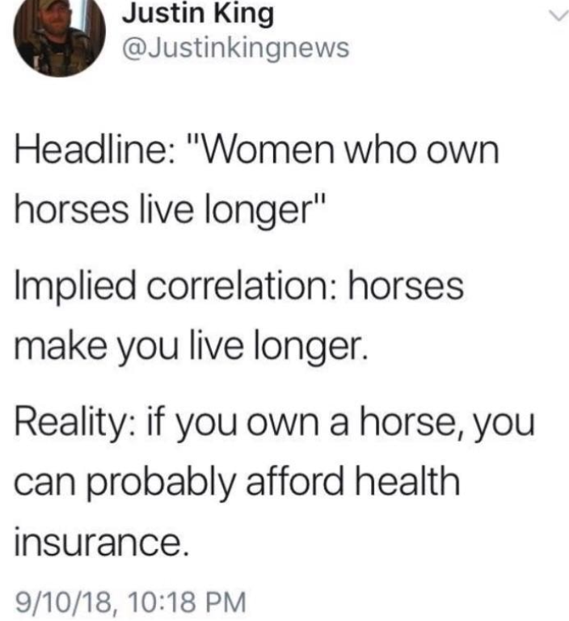
Correlation is NOT etc. etc.
“Having a horse makes you live longer!”
Horse
Health
Horse
Health
Horse
Health
Horse
RICH
Health

Slide 18
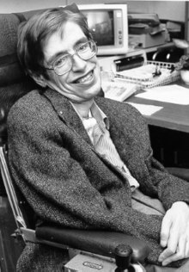
Human Understanding of ML
“The greatest enemy of knowledge is not ignorance, but the illusion of knowledge”
Notes:
We have to be really, really careful. Correlation does not mean causation.

Slide 19
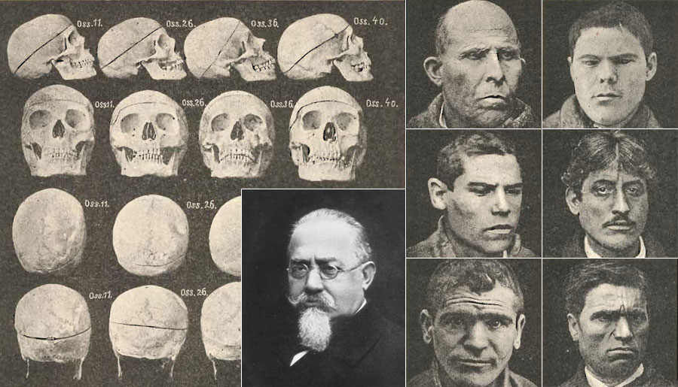
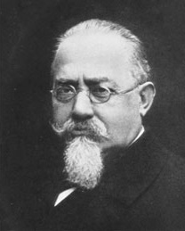
Excellent Failures: Bad Ideas
YOU UGLY,
YOU EVIL! LOL!
Notes:
So, this guy is an Italian, Cesare Lombroso. He lived between the 1800 and the early 1900 in the city I am coming from, Torino. He is famous because he invented the field of phrenology. You all probably know what phrenology is, it’s basically trying to characterize people from the shape of of their skull. His thought can be summed up by the quote “YOU UGLY YOU EVIL”, that he might have or have not said. His ideas have luckily been debunked during the 1900s. But of course, every now and then there’s a REVIVAL.

Slide 20
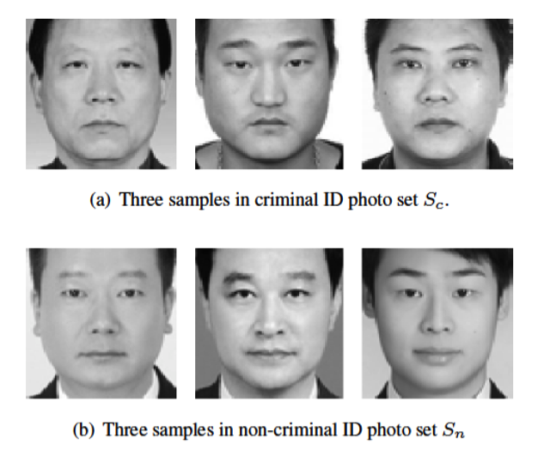
Excellent Failures: Bad Ideas
In 2018, Cesare Lombroso goes to China
Deep learning image recognition system
Classify innocent people and criminals
They tried to have good data
Photos with face only
50% criminals, 50% innocents
Result: 89.5% accuracy!
Notes:
I can picture them going like “HA! STUPID AMERICANS! THEY HAVE THESE UNBALANCED DATASETS, BUT WE ARE BETTER! WE ARE SMARTER THAN THEM!”

Slide 21
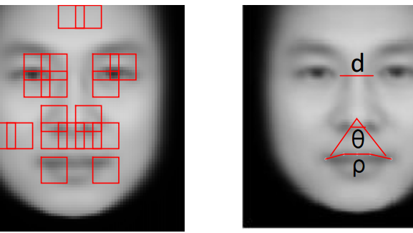
Interpretability of the Results
Visualization to analyze ML algorithm decision
Notes:
So, they analyzed the images, using visualization techniques to understand where the deep learning algorithm was looking at. What where the features that were actually used. And they found a weird angle, under the nose, between the nose and the corners of the mouth. And if that angle is narrow, you are more likely to be a criminal, if it’s wider you are more likely to be innocent.

Slide 22
Interpretability of the Results
APPREHENDED CRIMINALS DO NOT SMILE
Notes:
Now, this is extremely funny. It is MUCH LESS funny, if you imagine that a similar system could be used in China, which is not exactly a democracy, to prevent crime. SMILE, CITIZEN, OR YOU WILL GO TO JAIL.

Slide 23
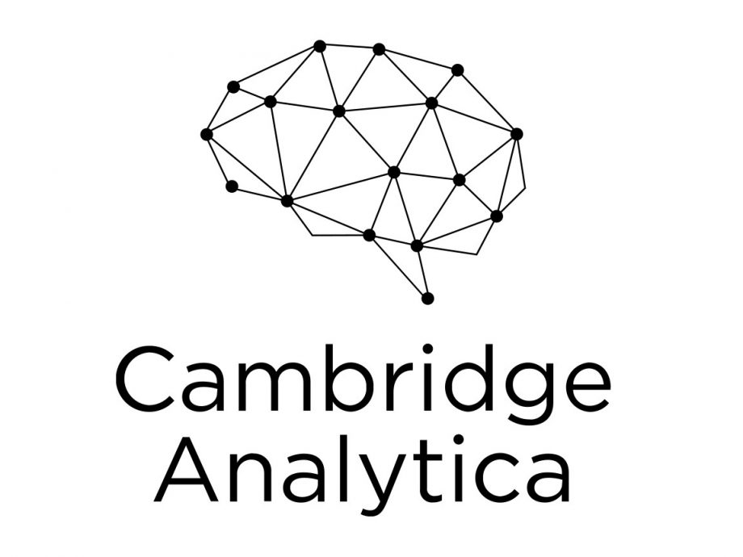
Even When Everything Works…
Everything works fine and STILL not good
Success story for ML…
…but is it a success for humans?
Cambridge Analytica
UK Company
Involved in Trump’s election and Brexit referendum
But how?
Notes:
What did they do? Did you follow the story?

Slide 24
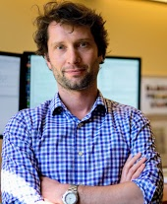
Machine Learns, Influences Humans
Everything starts with a Polish guy
Micheal Kosinski, PhD
Works on “Big 5” personality traits
Openness, conscientiousness, extroversion, agreeableness, neuroticism
CLASSIFY people using these FEATURES
Usually requires filling HUGE questionnaire
But can we find another way?

Slide 25
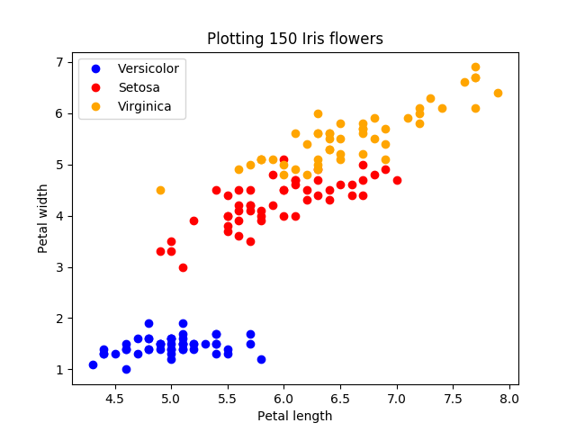
Machine Learns, Influences Humans
Correlation Facebook data - Big 5?
Start from data, people filled questionnaires
Look at their public FB information (likes)
Classification problem
Features: FB likes
Class: people typology

Slide 26

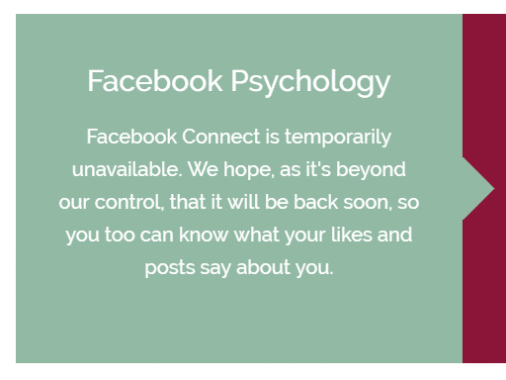

Machine Learns, Influences Humans
PINKIE PIE PROTECTS YOUR IDENTITY FROM MACHINE LEARNING
Excellent predictions!
Skin color (95%)
Sexual orientation (88%)
Political affiliation (85%)
Interesting correlations
Man likes cosmetics <-> Gay
Man likes Wu-Tang <-> Hetero
Notes:
We cannot longer access it, because – for reasons that we will see – Cambridge University kinda put this project on the side. I remember that when I took it, I was classified as a Lesbian with high confidence. Probably because of my likes to

Slide 27
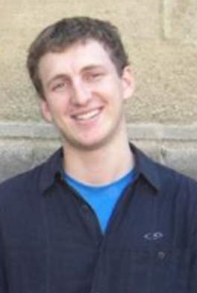
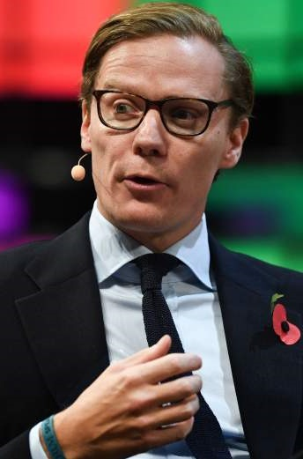
Machine Learns, Influences Humans
I was born in the USSR and (at least for a time) legally changed my name to Aleksandr SPECTRE, so you KNOW that DR. SPECTRE is the good guy in this story!
Who cares about your mom’s openness?
Advertisers!
Ads targeting “Big 5” typologies are VERY effective
Or at least, more effective than other kinds of ads
Enter Dr Aleksandr Kogan and Alexander Nix, aka GSR and Cambridge Analytica

Slide 28
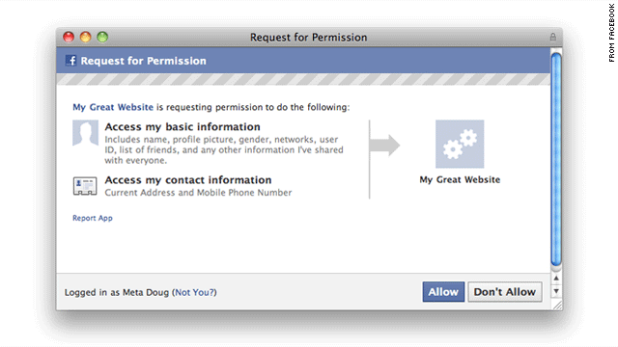
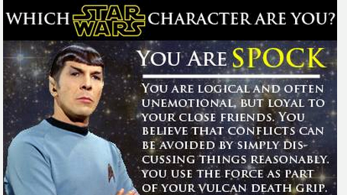
Machine Learns, Influences Humans
Gather data of around 50 Million individuals
Exploiting FB vulnerabilities and…
…DUMB personality tests
Apply Kosinski’s classification algorithm

Slide 29
Machine Learns, Influences Humans
Final result
Profiles with name and psychological type
Send targeted advertisement
Effectiveness?
Hard to tell…
But it might move a few %
Convince/disenfranchise
Notes:
For example,

Slide 30
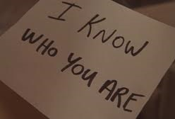
Machine Learning Knows You
Google has your search history
Google/Yahoo “read” your mails
Natural Language Processing
Flights/trains/hotels on calendar
Social networks KNOW you
Cambridge A. used a tiny part of public data
Facebook/Twitter/Instagram has EVERYTHING
If not from you, from your friends
Notes:
Now, we’ve seen this case study of Cambridge Analytica. Many of you will think “ok, but I am not so stupid. I will not give my data to a Facebook application that tells me which character of The Big Bang Theory looks more like me. By the way, for me it’s Leonard.

Slide 31

Machine Learning Knows You
What is the objective?
Mostly selling you stuff (ads, etc.)…
…for now!
DO NOT RELAX
What about totalitarian states?
What can they do using ML?
Big companies do not care much
Notes:
You know. You have an idea. You heard the stories. Can you imagine what STASI could have been, with machine learning?

Slide 32
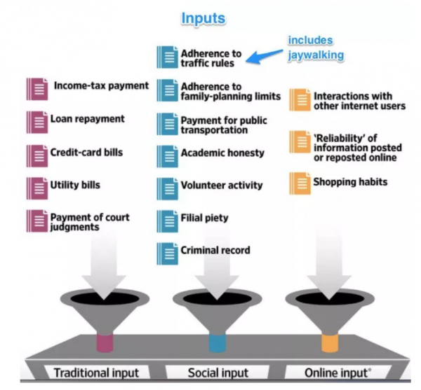

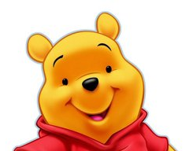
Machine Learning Knows You
PEOPLE’S REPUBLIC OF ANIHC
PRESIDENT
Notes:
Again, this is happening now.

Slide 33
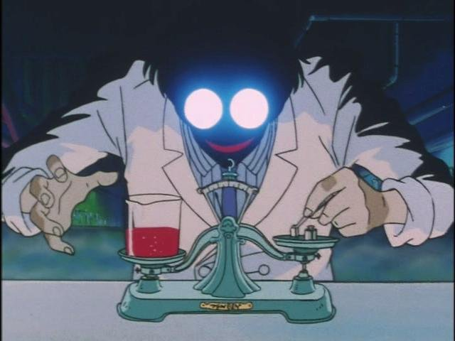
Conclusions
YOU have to be careful
“Where is the data coming from?”
“How was it collected?”
“Is it unbiased?”
Because computer scientists are NOT (always)
GOOD, MY PREDICTION ACCURACY INCREASED FROM 85% TO 87%!
WHAT AM I CLASSIFYING?
WHO CARES!
POLITICAL DISSIDENTS, YOU SAY…? UOPS…
Notes:
There is a rising concern about ethics in computer science and machine learning. But computer scientists are not used to it, me included. We don’t really care about HOW our research is going to be used. For us, the focus is make it work.

